Slide 1
Security
UBMS Stem Experience: Jurassic Park
Notes:
Video on device differences: https://www.youtube.com/watch?v=Vc16CCAAz7Q

Slide 2
IP Addresses and Ports

Slide 3


Slide 4
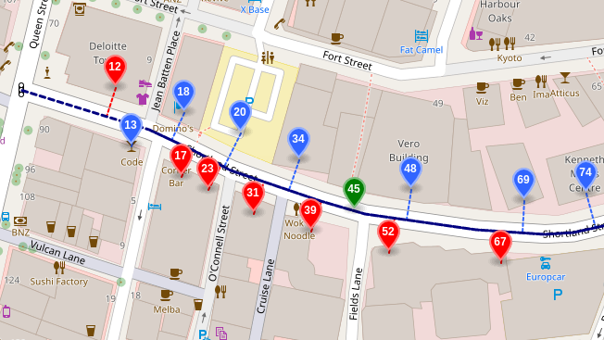

Slide 5


Slide 6

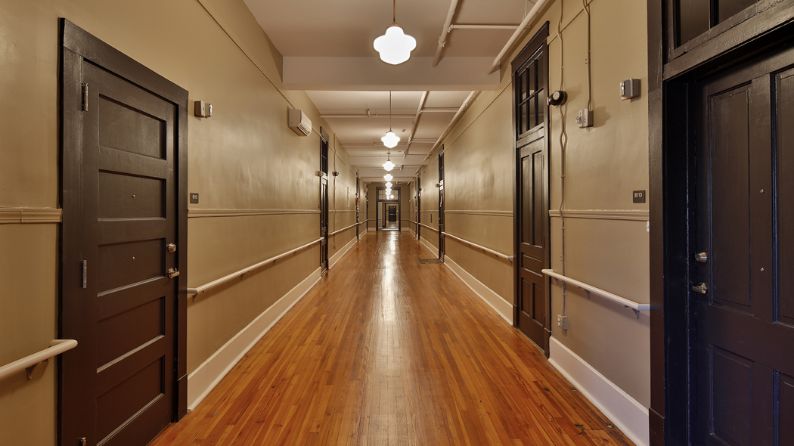

Slide 7


Slide 8
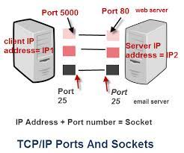
Sockets
When connecting to a server, you must create a connection called a socket
Sockets = IP Address + Ports
The port on the server is fixed per application
The port from the client is random

Slide 9
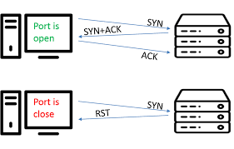
Port Scanning
Attacker
Target
Attacker sends a probe to ports on a target
The attacker figures out if the port is open by how the target responds
Imagine it’s like knocking on doors at an apartment complex to figure out if it’s occupied or not.

Slide 10
Vulnerabilities and Exploits

Slide 11
Vulnerabilities and Exploits

Slide 12
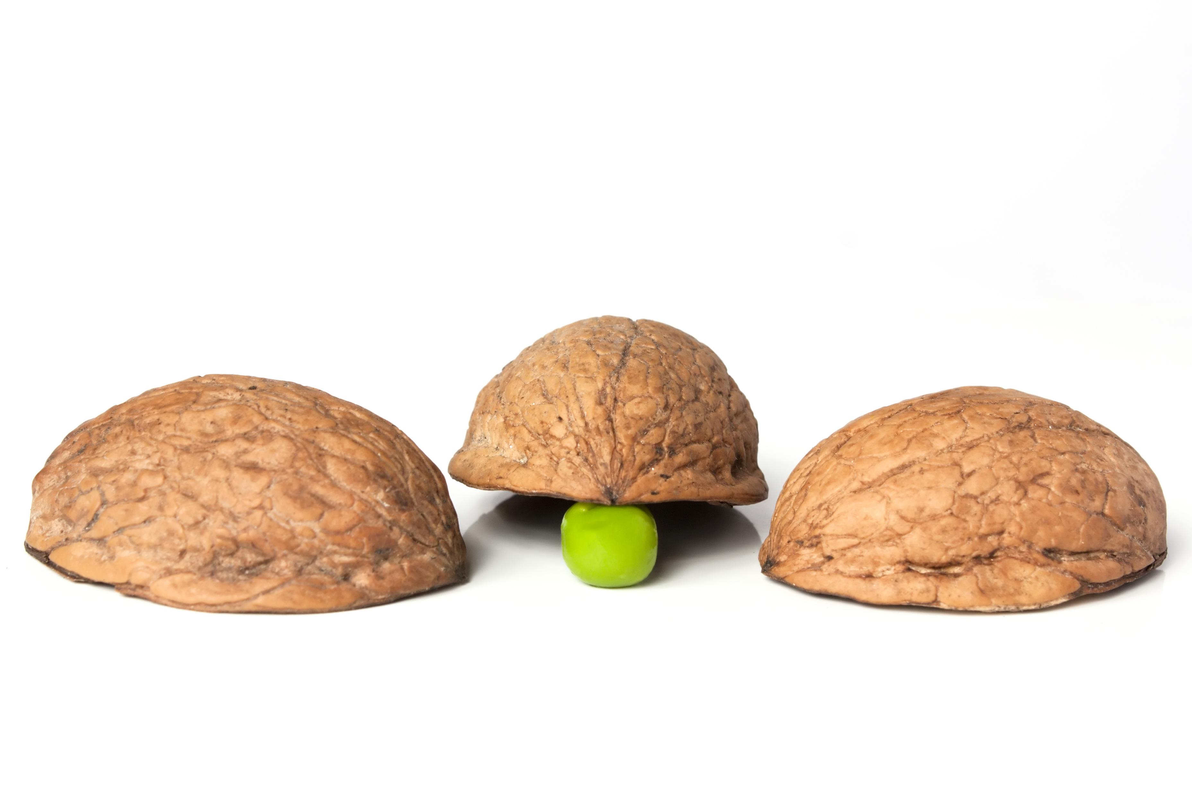
Shell game takes advantage of several vulnerabilities
Greed
Trust
Over-confidence
Lack of focus
Exploits vulnerabilities to take money from people

Slide 13
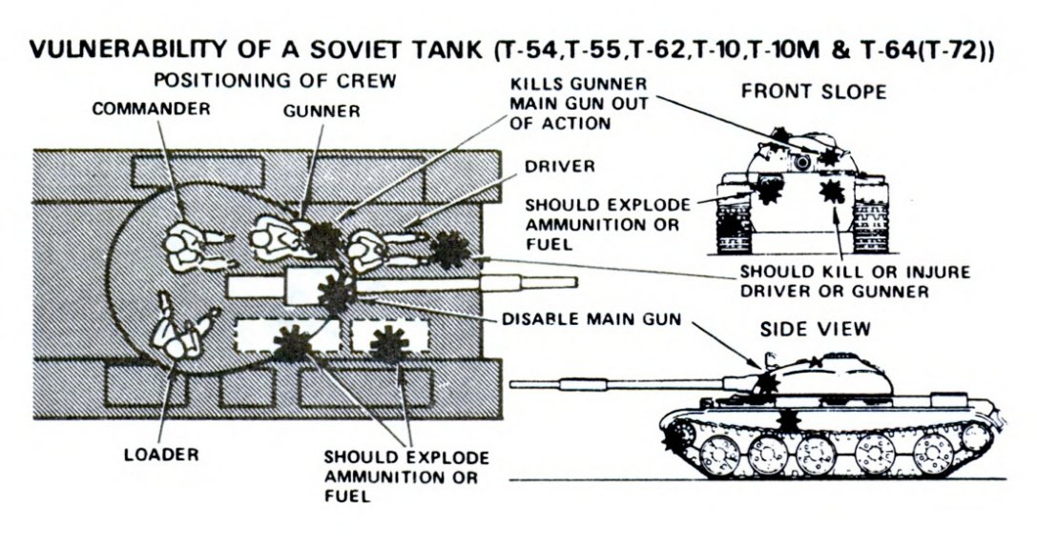

Slide 14

Software and system vulnerabilities are a result of errors in coding or design
Exploits are designed to make a system do something it wasn’t designed to do that benefits the hacker

Slide 15
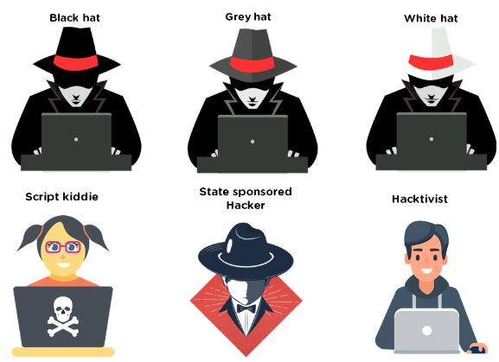
Types of Hackers
Black Hat - Criminal Hackers
White Hat - Ethical Hackers
Grey Hat - People who toe the line
Hacktivist - Hackers who hack illegally for a “good” cause
State sponsored hacker - Illegal hackers who are backed by a government
Script Kiddie - people who pretend to be hackers but don’t really know what they’re doing

Slide 17
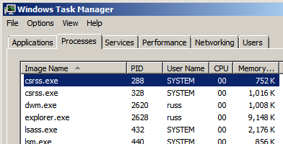
Processes
All the different parts of the operating system
Each process is assigned an ID, called a Process ID or PID
Malicious code can hide itself inside of processes

Slide 18
Protections

Slide 19
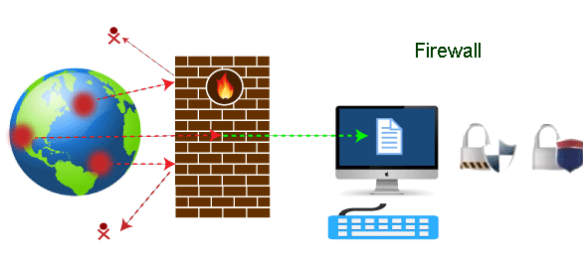

Slide 20

No security is perfect

Slide 21


Bypassing Protection
Exploits bypass security measures
It doesn’t matter how big a wall is if you can get someone on the inside to open a door

